Slide 1
Site Induction Slides for Sophia Gardens
A Site Supervisor will be allocated to your event to help Cardiff Council balance and manage:
The needs of the event organiser
The financial and reputational interests of the venue (with Parks Dept. as Landlord)
Safety and experience of the wider public using the park
1. Sophia Gardens event area is an area of green space close to the city centre, just south of the Sophia Gardens pay and display car park
2. The site is accessible by foot from the city centre or by vehicle via Sophia Close off Cathedral Rd
3. Sophia Gardens is a Grade 2 listed historic landscape as designated by Cadw, Welsh Government
Sophia Gardens – Site Induction Notes for Event Organisers and Site Supervisors 1 of 15
Dated 16-08-17

Slide 2
Venue-specific information – Sophia Gardens (1)
The below venue information is brought to the Event Organiser’s attention to help CDM planning:
Vehicles can drive onto the site by removal of lockable bollards along the Venue’s west side
Unauthorised parking may block vehicle access onto site. Access routes should be secured in advance to prevent delays
The event area is accessible by pedestrians at all times unless securely fenced
The Sophia Gardens car park and P&D bays along the Sophia Gardens Spine Rd are taken over by Cardiff Council’s traffic stewards when the Millennium Stadium/SWALEC Stadium are in event mode. Check Cardiff City Events Schedule for clashes with your dates of hire
Power and water are available on site. The Site Supervisor can grant access on request
There is the potential for crime and anti-social behaviour as may be expected in any city-centre park
Sophia Gardens – Site Induction Notes for Event Organisers and Site Supervisors 2 of 15

Slide 3
Venue-specific information – Sophia Gardens (2)
The below venue information is brought to the Event Organiser’s attention to help CDM planning:
The site itself is unlit and dark after sunset
The vicinity of the event area can be busy. It is used by pedestrians, cyclists and other vehicles. These may share paths and roads with the event audience and vehicles
The site is close to businesses and private residences
Noise disturbance to these adjacent premises must be considered and planned for to prevent nuisance
Businesses and private residences share the vehicle access route to the event area
In wet weather the ground can get very soft and water may stand on the surface of roads and grass
Sophia Gardens – Site Induction Notes for Event Organisers and Site Supervisors 3 of 15

Slide 4
Venue-specific information – Sophia Gardens (3)
The below venue information is brought to the Event Organiser’s attention to help CDM planning:
There are buried services in and around the Venue. Where known, these are identified on the event area base plan http://bute-park.com/wp-content/uploads/2013/12/Appendix-V2a-Sophia-Gardens-Event-Area-site-info.pdf . However, the Venue accepts no responsibility for the accuracy of this plan. The Principle Contractor is responsible for requesting up-to-date RASWA (Road and Street Works Act) searches and identifying the presence of services (e.g. CAT scanning) if he intends to break ground in or around the Venue. The Venue can obtain RASWA searches on request.
There are no existing welfare facilities on site.
Sophia Gardens – Site Induction Notes for Event Organisers and Site Supervisors 4 of 15

Slide 5
The Role of the Site Supervisor /
Site Handover Meeting (1)
In advance of your event the Site Supervisor will be given:
Event Production Schedule
Event Site plan
Access and egress routes for event traffic
List of key points of contact
Specific requirements of the job (Site Supervisor briefing note)
The Site Supervisor’s briefing note will advise if the following are required:
Access to event signage
Access to trackmats
Access to heras banners
Access to on-site water/power supplies (and therefore pre and post meter readings)
Access to designated parking areas/unlocking of certain site padlocks
A list of the pre-approved event caterers
Additional event-specific tasks
A list of any pre-arranged late collections which will take place after the site handback meeting (if required)
Sophia Gardens – Site Induction Notes for Event Organisers and Site Supervisors 5 of 15

Slide 6
The Role of the Site Supervisor /
Site Handover Meeting (2)
A Site Handover Meeting will be scheduled for 1hr before the first planned activity in the Event Schedule.
The handover meeting should be conducted with the senior responsible person on site and cover the following topics:
Safe traffic management, sharing knowledge and experience of the site
Organiser’s responsibility to adequately protect the ground/grass/site furniture from damage
Organiser’s responsibility to adequately protect trees from damage, though these are outside of the event area so should naturally be avoided
Organiser’s liability for fines and repair costs if they fail in their duty
The Site Supervisor will:
Share their knowledge and experience of the site
Advise organisers on how they can optimally manage things based on their prior experience
The event organiser does not have to take Site Supervisor’s advice and ultimately remain responsible for success or failure of each event
Sophia Gardens – Site Induction Notes for Event Organisers and Site Supervisors 6 of 15

Slide 7
The Role of the Site Supervisor /
Site Handover Meeting (3)
During the handover meeting the Site Supervisor will document:
The condition of the site infrastructure using the appropriate template form in the Site Supervisor File
Mark up the Event Site Base Plan to show any existing damage or problem areas
The starting meter readings for any utility supplies requested for use by the event
Weather conditions on the day and the current forecast for the hire period (this should be known by the event organisers as is relevant information for their safe management of the site)
Take photos of existing damage that the Parks Office need to be aware of
Sophia Gardens – Site Induction Notes for Event Organisers and Site Supervisors 7 of 15

Slide 8
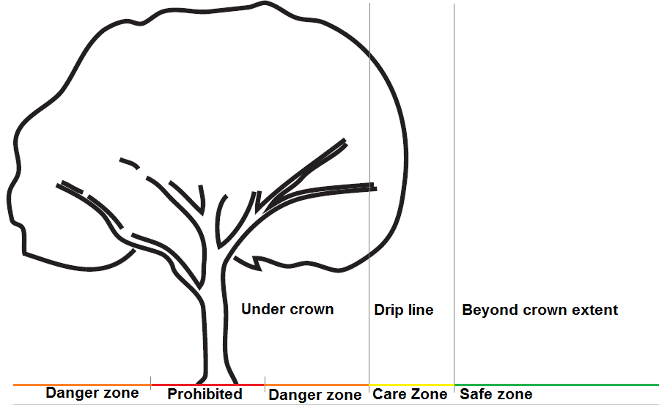
Tree Protection
The following diagram summarises the policy on tree protection
Is the end of the root protection area (RPA)
Consult and Care Zone (1m beyond stem base to edge of rooting zone)
1m from stem base
Consult and Care Zone (1m beyond stem base to edge of rooting zone)
Beyond extent of rooting zone (at least beyond canopy edge/drip line if no other info available)
Sophia Gardens – Site Induction Notes for Event Organisers and Site Supervisors 8 of 15

Slide 9
Prohibited zone
- Strictly no event activity accept pedestrian use
- Physical barrier required if at risk of encroachment by event activities
- Site Supervisor to enforce
Is the end of the root protection area (RPA)
Consult and Care Zone (1m beyond stem base to edge of rooting zone)
1m from stem base
Consult and Care Zone (1m beyond stem base to edge of rooting zone)
Beyond extent of rooting zone (at least beyond canopy edge/drip line if no other info available)
Sophia Gardens – Site Induction Notes for Event Organisers and Site Supervisors 9 of 15

Slide 10
Consult and Care Zone
- If used by event some form of ground/tree protection may be required. Requirements should be discussed with Parks Department
- Seek further advice from Parks Department if necessary
- Site Supervisor, refer to event-specific briefing notes
Is the end of the root protection area (RPA)
Consult and Care Zone (1m beyond stem base to edge of rooting zone)
1m from stem base
Consult and Care Zone (1m beyond stem base to edge of rooting zone)
Beyond extent of rooting zone (at least beyond canopy edge/drip line if no other info available)
Sophia Gardens – Site Induction Notes for Event Organisers and Site Supervisors 10 of 15

Slide 11
Safe Zone
- Event activity permitted without additional tree protection measures
- Ground protection may still be required for safe vehicle and pedestrian access or to prevent a ground pollution incident
Is the end of the root protection area (RPA)
Consult and Care Zone (1m beyond stem base to edge of rooting zone)
1m from stem base
Consult and Care Zone (1m beyond stem base to edge of rooting zone)
Beyond extent of rooting zone (at least beyond canopy edge/drip line if no other info available)
Sophia Gardens – Site Induction Notes for Event Organisers and Site Supervisors 11 of 15

Slide 12
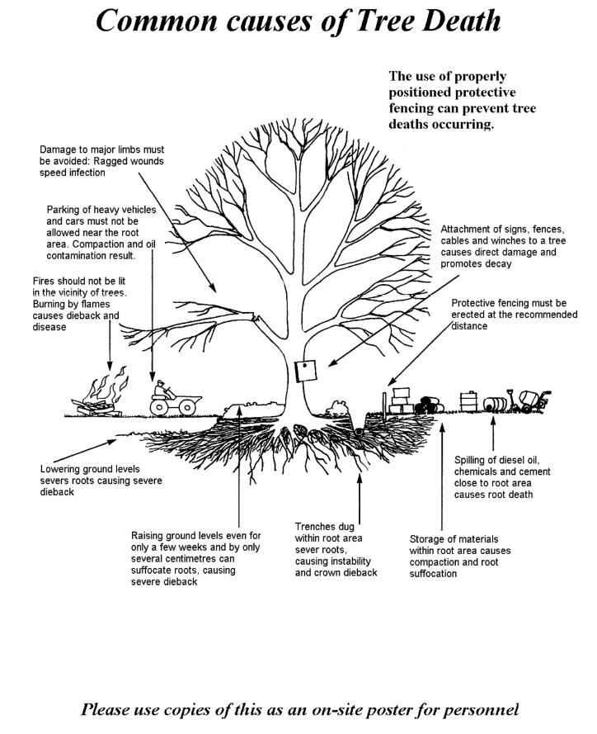
Tree Protection
Event organisers should identify risks to tree health and highlight as part of their staff site induction
Some possible risks to tree health are summarised in the diagram to help you
The Site Supervisor will identify risks to tree health on site and ask the event organiser to take corrective action
Seek further advice from the Parks Department if you are not sure
Sophia Gardens – Site Induction Notes for Event Organisers and Site Supervisors 12 of 15

Slide 13
The Role of the Site Supervisor /
During the event (1)
Site Supervisor duties during the event include:
The identification, recording and reporting of incidents
Incidents may include:
Damage to site infrastructure
Ground pollution incidents (regularly check toilets, plant and generators for leaks)
Damage to trees
Road traffic accidents
Personal injury
Taking photographs to act as evidence in insurance and repair cost claims
Taking notes of observations that can be fed back to event organisers to support future improvements
Taking photographs that will be useful for the event management archive or record issues that need to be followed up with event organisers
Sophia Gardens – Site Induction Notes for Event Organisers and Site Supervisors 13 of 15

Slide 14
The Role of the Site Supervisor /
During the event (2)
Site Supervisor duties during the event include:
Ensuring that only pre-approved caterers with the required 3 or above food hygiene rating are permitted onto site
Reporting issues in line with the list of key contacts provided
Facilitation of the event organiser’s logistics, e.g. providing access where and when required
Anticipate and prevent damage to grass and trees as far as practically possible, monitor the effectiveness of the event organiser’s ground protection plans
Consulting with the Parks Office should the Event Organiser request any changes they are unsure about approving
Ensure no petrol generators are brought onto site
Ensure plant have low pressure grass tyres to prevent rutting to the ground
Sophia Gardens – Site Induction Notes for Event Organisers and Site Supervisors 14 of 15

Slide 15
The Role of the Site Supervisor /
The handback meeting
The last activity on site should be to conduct a formal handback meeting (Site Supervisor and event organiser). This should be itemised in the event production schedule.
The handback meeting should take place with the senior responsible person on site and include the following:
The condition of the site infrastructure post-event, including photographs to act as evidence in insurance and repair cost claims and updates made on the Event Site Base Plan
The closing meter readings
Note any event equipment/litter still on site and what the organiser’s intention is to remove it
If this is different to the pre-arranged collections you must notify the Parks Office as this is only permitted by prior arrangement
It may be necessary to book additional Site Supervisor or Park Ranger time to manage this
Sophia Gardens – Site Induction Notes for Event Organisers and Site Supervisors 15 of 15

